Slide 2
دانشگاه علوم پزشكي قم
مرکز بهداشت شهرستان
دوره آموزشی
« روشهای کنترل صدا در محیط کار »
(1395/6/08)
مدرّس:
علیرضا مشکوری
عضو هیئت علمی دانشکده بهداشت قم
(E-mail: amashkouri@muq.ac.ir)
فراگیران:
کارشناسان بهداشت حرفه ای استان قم

Slide 3
برنامه کارگاه:
پارامترهای اندازه گیری صدا در محیط کار
روشهای اندازه گیری صدا در محیط کار و نحوه کار با دستگاه های صداسنج
راهکارهای کنترل صدا در محیط کار

Slide 4
بخش اول:
پارامترهای اندازه گیری صدا در محیط کار

Slide 5
Type of noise:
Steady-Continuous
Non steady-fluctuating
Impulsive and impact
Broadband
Narrow band
Infra sound
Ultra sound

Slide 6
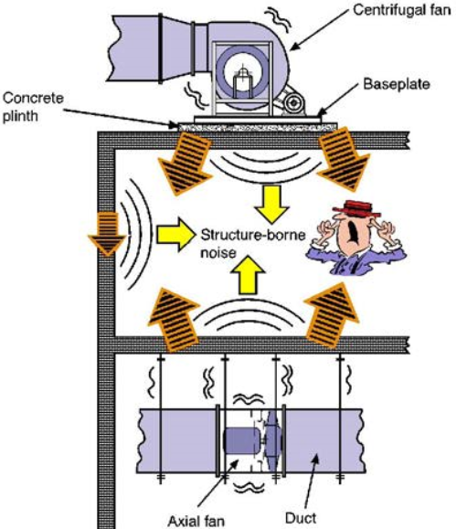

Slide 7
Measured Parameters

Slide 8
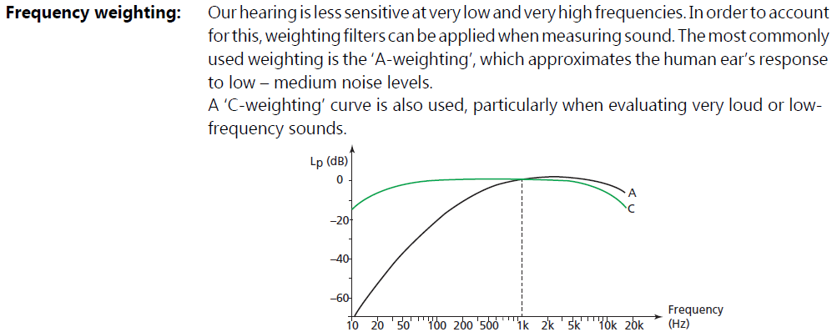
Measured Parameters

Slide 9
Measured Parameters

Slide 10
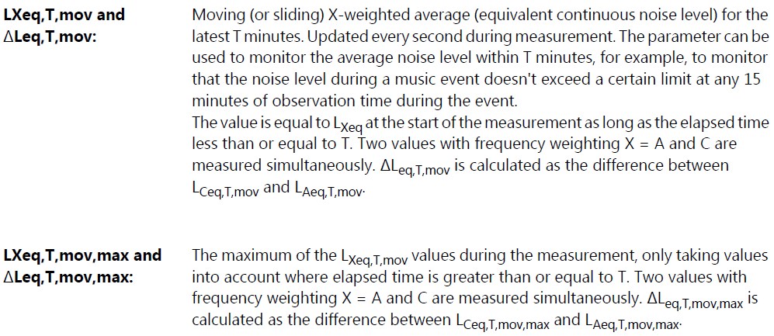
Measured Parameters

Slide 11
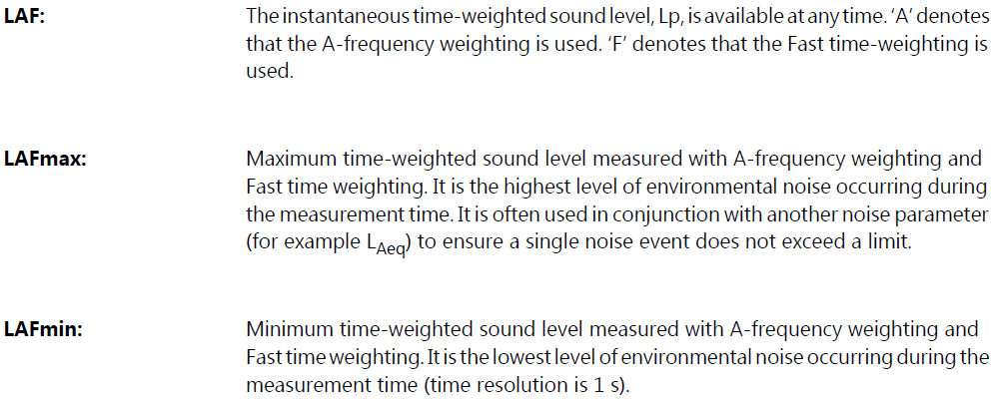
Measured Parameters

Slide 12
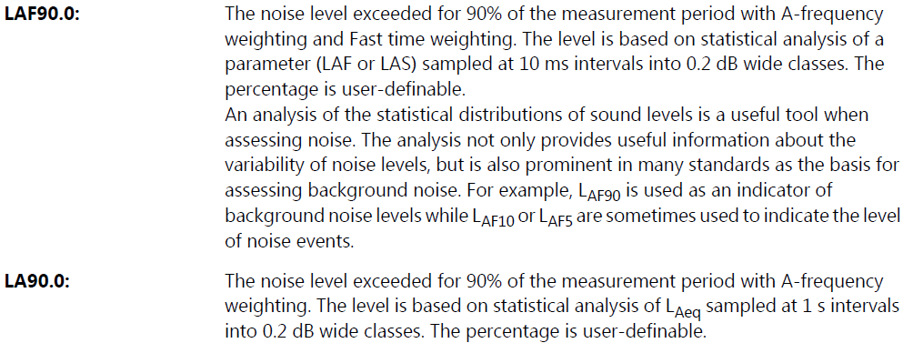
Measured Parameters

Slide 13
Measured Parameters

Slide 14
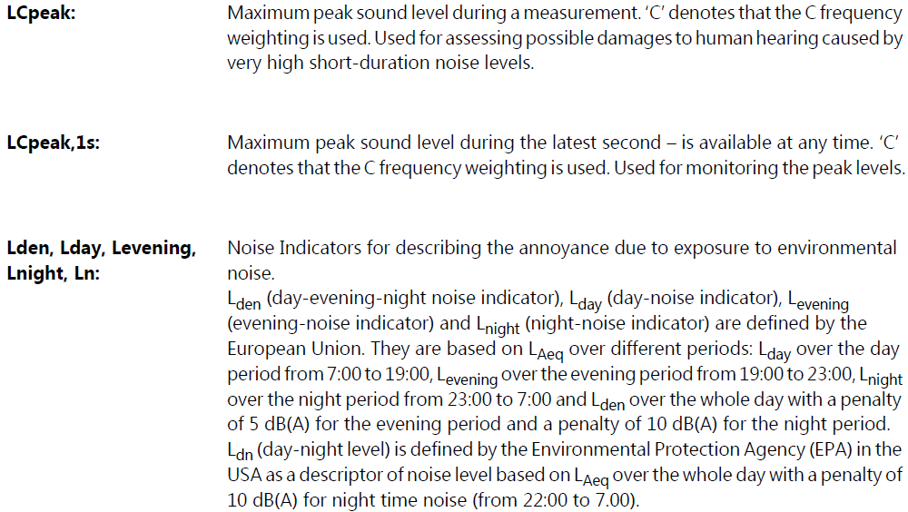
Measured Parameters

Slide 15
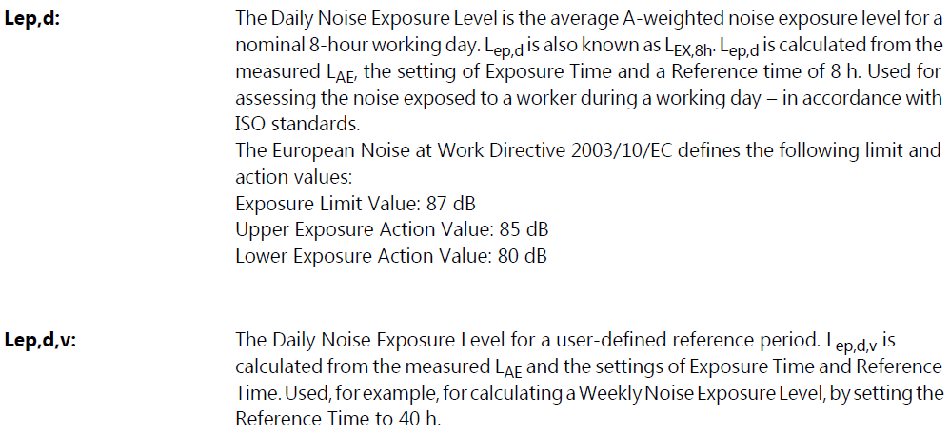
Measured Parameters

Slide 16
Measured Parameters

Slide 17
Measured Parameters

Slide 18
Measured Parameters

Slide 19
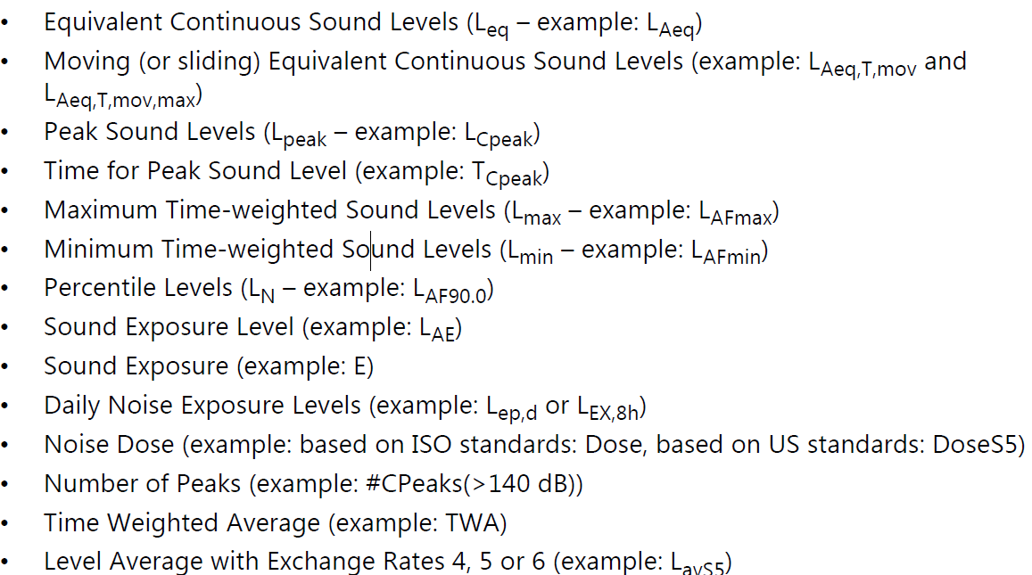
Timed Measured Parameters

Slide 20
بخش دوم:
روشهای اندازه گیری صدا در محیط کار و
نحوه کار با دستگاه های صداسنج

Slide 21
Why measure noise in the workplace?
Measuring noise levels and workers' noise exposures is the most important part of a workplace hearing conservation and noise control program.
It helps identify work locations where there are noise problems, employees who may be affected, and where additional noise measurements need to be made.

Slide 22
How is workplace noise measured?
For occupational hygiene purposes, the sound pressure level is measured to determine noise exposures.
Various instruments and techniques may be used.
The choice depends on the workplace noise and the information needed.

Slide 23
How do you identify noise problems in the workplace?
The first step is to determine whether or not noise is a potential problem in your workplace. A walk-through survey helps in making this decision. The indicators of potentially hazardous noise level include:
Noise is louder than busy city traffic.
People have to raise their voice to talk to someone at one meter (3 feet) away.

Slide 24
…
At the end of work shift people have to increase the volume of their radio or TV to a level too loud for others.
After working for a few years at that workplace, employees find it difficult to communicate in a crowd or party situation where there are other sounds or many voices.
Noise measurement data from studies in similar situations are very helpful in assessing the potential noise problem.

Slide 25
What things do you consider when planning noise measurement?
Before taking field measurements, it is important to determine the type of information required. The person making the measurement must understand:
•The purpose of measurement: compliance with noise regulations, hearing loss prevention, noise control, community annoyance etc.
•The sources of noise, and times when the sources are operating.
•The temporal pattern of noise - continuous, variable, intermittent, impulse.
•Locations of exposed persons.

Slide 26
…
The initial measurements are noise surveys to determine if:
•Noise problem exists.
•Further measurements are needed.
The second step is to determine personal noise exposure levels; that is, the amount of noise to which individual employees are exposed. If the workplace noise remains steady, noise survey data can be used to determine employee exposures. However, noise dosimetry is necessary if the workplace noise levels vary throughout the day or if the workers are fairly mobile.

Slide 27
What types of instruments are used for measuring noise?
The most common instruments used for measuring noise are the sound level meter (SLM), the integrating sound level meter (ISLM), and the noise dosimeter.
It is important that you understand the calibration, operation and reading the instrument you use.
The user's manual provided by the instrument manufacturer provides most of this information.

Slide 28
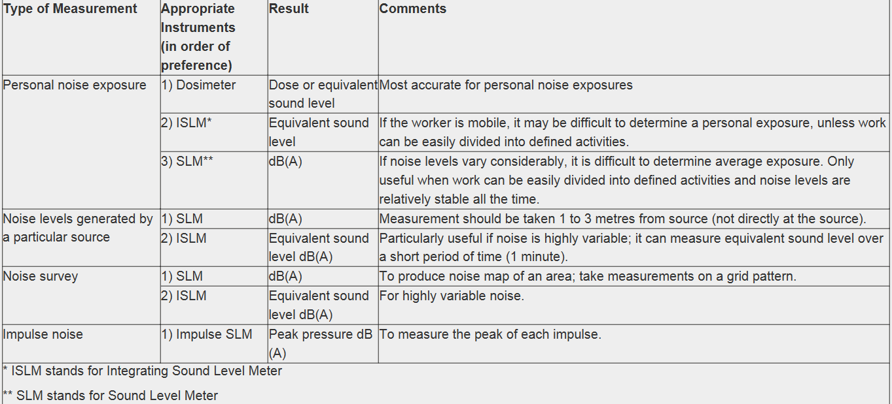
Guidelines for Instrument Selection

Slide 29
What is a sound level meter (SLM)?
The SLM consists of a microphone, electronic circuits and a readout display. The microphone detects the small air pressure variations associated with sound and changes them into electrical signals. These signals are then processed by the electronic circuitry of the instrument. The readout displays the sound level in decibels. The SLM takes the sound pressure level at one instant in a particular location.
To take measurements, the SLM is held at arm's length at the ear height for those exposed to the noise. With most SLMs it does not matter exactly how the microphone is pointed at the noise source.
The instrument's instruction manual explains how to hold the microphone. The SLM must be calibrated before and after each use. The manual also gives the calibration procedure.

Slide 30
…
With most SLMs, the readings can be taken on either SLOW or FAST response. The response rate is the time period over which the instrument averages the sound level before displaying it on the readout. Workplace noise level measurements should be taken on SLOW response.
A Type 2 SLM is sufficiently accurate for industrial field evaluations.
The more accurate and much more expensive Type 1 SLMs are primarily used in engineering, laboratory and research work. Any SLM that is less accurate than a Type 2 should not be used for workplace noise measurement.

Slide 31
…
An A-weighting filter is generally built into all SLMs and can be switched ON or OFF. Some Type 2 SLMs provide measurements only in dB(A), meaning that the A-weighting filter is ON permanently.
A standard SLM takes only instantaneous noise measurements. This is sufficient in workplaces with continuous noise levels. But in workplaces with impulse, intermittent or variable noise levels, the SLM makes it difficult to determine a person's average exposure to noise over a work shift. One solution in such workplaces is a noise dosimeter.

Slide 32
What is an integrating sound level meter (ISLM)?
The integrating sound level meter (ISLM) is similar to the dosimeter. It determines equivalent sound levels over a measurement period. The major difference is that an ISLM does not provide personal exposures because it is hand-held like the SLM, and not worn.
The ISLM determines equivalent sound levels at a particular location. It yields a single reading of a given noise, even if the actual sound level of the noise changes continually. It uses a pre-programmed exchange rate, with a time constant that is equivalent to the SLOW setting on the SLM.

Slide 33
What is a noise dosimeter?
A noise dosimeter is a small, light device that clips to a person's belt with a small microphone that fastens to the person's collar, close to an ear.
The dosimeter stores the noise level information and carries out an averaging process.
It is useful in industry where noise usually varies in duration and intensity, and where the person changes locations.

Slide 34
…
A noise dosimeter requires the following settings:
(a) Criterion Level: exposure limit for 8 hours per day five days per week. Criterion level is 85 dB(A) for many jurisdictions.
(b) Exchange rate: 3 dB or 5 dB as specified in the noise regulation.
(c) Threshold: noise level limit below which the dosimeter does not accumulate noise dose data.

Slide 35
Wearing the dosimeter over a complete work shift gives the average noise exposure or noise dose for that person. This is usually expressed as a noise exposure level. This is a logarithm which takes into account the exposure and the actual time worked.
In the past, it was often expressed as a percentage of the maximum permitted exposure. If a person has received a noise dose of 100% over a work shift, this means that the average noise exposure is at the maximum permitted. For example, with a criterion level of 90 dB(A) and an exchange rate of 3 dB(A), an eight-hour exposure to 90 dB(A) gives a 100% dose. A four-hour exposure to 93 dB(A) is also a 100% dose, whereas an eight-hour exposure to 93 dB(A) is a noise dose of 200%.

Slide 36
Dosimeters also give an equivalent sound or noise level. This is the average exposure level for noise over the time dosimeter was on. It has the same total sound energy as the actual, variable sound levels to which a person is exposed over the same time period.
Scientific evidence suggests that hearing loss is affected by the total noise energy exposure. If a person is exposed over an eight-hour work shift to varying noise levels, it is possible to calculate an equivalent sound level which would equal the same total sound energy exposure. This would have the same effect on the person's hearing as the variable exposure actually received.

Slide 37
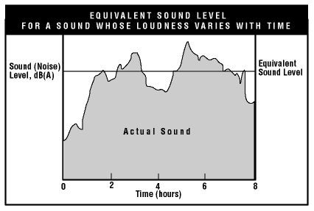
In Figure, the shaded area under the line that shows how the sound level changes over time (the "curve") represents the total sound exposure over eight hours.

Slide 38
When do you use a windshield?
When air blows by the microphone, the noise reading is altered.
To avoid the effect of wind, one uses a windshield or windscreen to cover the microphone in areas with considerable air movement. Wind shields or screens are available from manufacturers of sound level meters.

Slide 39
What techniques are used for measuring noise?
Before taking any field measurements, it is important to determine the type of information required. Do the workplace noise levels vary throughout the day? Are the workers fairly mobile?
In a bottle washing and filling facility in Ontario, for example, the noise levels vary over the work shift. Instantaneous noise measurements, taken with an SLM (Type 2, SLOW RESPONSE, A-filter), at one person's work station, ranged from 63 dB(A) to 114 dB(A) over the day, although levels most commonly ranged from 90 to 96 dB(A) and 104 to 107 dB(A). This information strongly suggested that there was a potential for excessive noise exposure.

Slide 40
…
The worker was asked to wear a noise dosimeter over a full eight-hour work shift. At the end of the shift, the noise dosimeter indicated a 270% dose. This was a substantial exposure. In addition, the dosimeter provided an equivalent noise level of 97 dB(A). In other words, a constant eight-hour exposure to a steady, continuous noise of 97 dB(A) would have resulted in the same exposure.
An ISLM could also have been used in this example, particularly if the worker spent most of the work shift in a defined location, or the first half of the shift in one area and the remainder in another area. The ISLM could have provided equivalent sound level measurements and a fairly accurate exposure assessment.

Slide 41
How is impulse/impact noise measured?
Measurements of impulse or impact noise depend on the guidelines and standards in force. Before you measure impact or impulse noise, you must ensure that the equipment has the capacity to measure this kind of noise.
Normally measurements of either peak noise levels together with the actual number of peaks, or percentage dose or equivalent sound levels are required. Where there is little background noise, as for example on an outdoor rifle range, the measuring of peak pressures may be most appropriate.
In industrial settings, there is usually considerable background noise in addition to the impulse noise. In such cases, provided that a 3 dB(A) exchange rate is used, dosimeters or ISLMs which are sufficiently sensitive to respond well to peaks may be more appropriate. One can account for all of the noise, continuous and impulse, in the one measurement.

Slide 42
What is a frequency analysis?
Frequency analysis is measuring noise level at each frequency or pitch.
Frequency analysis is not required when the purpose of noise measurement is to assess compliance with regulatory exposure limits or to assess risk of hearing loss. For such purposes the A-weighted noise level in dB(A), percent noise dose or time-weighted average (TWA) equivalent sound level is sufficient.
The frequency analysis is usually needed only for the selection of appropriate engineering control methods.

Slide 43
…
Octave bands are identified by their center frequency.
The band width increases as the center frequency increases.
The audible sound frequency range (approximately 20 to 20,000 Hz) has been divided into 11 octave bands for this purpose.
An octave band filter set can be attached to an SLM to measure the sound level in each octave band.

Slide 44
When and how do you make corrections for background noise?
Sometimes it is necessary to determine whether or not the background noise is influencing the total noise level measured when the noise source is "on".
In such cases, two readings of noise level are taken - one with the noise source "on" and the other with the noise source "off". The following table can be used to determine noise level due to the noise source.
For example if the total noise level is 97 dB and the background noise is 90 dB, the noise due to source is 96 dB (97-1). If the difference is more than 10 dB, no correction is needed.

Slide 45
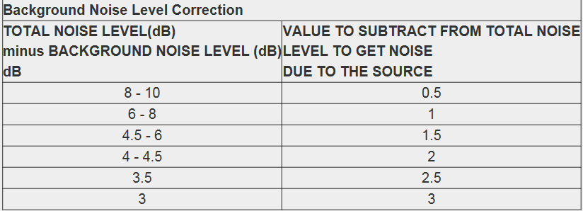

Slide 46
What is a noise survey?
A noise survey takes noise measurements throughout an entire plant or section to identify noisy areas.
Noise surveys provide very useful information which enables us to identify:
Areas where employees are likely to be exposed to harmful levels of noise and personal dosimetry may be needed.
Machines and equipment which generate harmful levels of noise.
Employees who might be exposed to unacceptable noise levels.
Noise control options to reduce noise exposure.

Slide 47
…
Noise survey is conducted in areas where noise exposure is likely to be hazardous. Noise level refers to the level of sound.
A noise survey involves measuring noise level at selected locations throughout an entire plant or sections to identify noisy areas. This is usually done with a sound level meter (SLM).
A reasonably accurate sketch showing the locations of workers and noisy machines is drawn.
Noise level measurements are taken at a suitable number of positions around the area and are marked on the sketch.
The more measurements taken, the more accurate the survey is. A noise map can be produced by drawing lines on the sketch between points of equal sound level. Noise survey maps, like that in Figure 2, provide very useful information by clearly identifying areas where there are noise hazards.

Slide 48
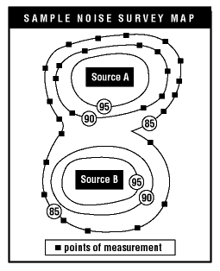
The SLM must be calibrated before and after each use. The manual gives the calibration procedure. To take measurements, the SLM is held at arm's length at the ear height for those exposed to the noise.

Slide 49
When the purpose of noise measurement is to assess the risk of hearing loss, the microphone position should be as close as possible to the location of the ears of the employee for whose benefit the noise exposure data are being taken.
Shielding by presence of employee and other objects between the noise source and microphone should be avoided. The employee need not be present during the measurement.
For a stationary employee, the microphone should be positioned above the shoulder or as near as feasible.
The microphone should be located within 0.5 meter of the employee's shoulder. If the employee works in a standing position, the microphone should be positioned preferably 1.5 meters above the floor. If the employee works in a sitting position, the microphone should be positioned at 1.1 meters above the floor.

Slide 50
A standard SLM takes only instantaneous noise measurements.
This is sufficient in workplaces with continuous noise levels. But in workplaces with impulse, intermittent or variable noise levels, the SLM makes it difficult to determine a person's average exposure to noise over a work shift. One solution in such workplaces is a noise dosimeter.

Slide 51
Sound Level Meter - Type 2250
Uses
•General-purpose Class 1 sound measurements to the latest international standards
•Occupational noise assessment
•Environmental noise assessment and logging
•Product development and quality control
•Building acoustics measurements
•Tone assessment using 1/3‐octave
•Loudness and noise rating measurements
•Low‐frequency building vibration according to ISO 8041:2005 and DIN 45669 – 1:2010 – 09
•Infrasound (G‐weighting) measurements according to ISO 7196:1995 and ANSI S1.42 – 2001 (R2011)

Slide 52
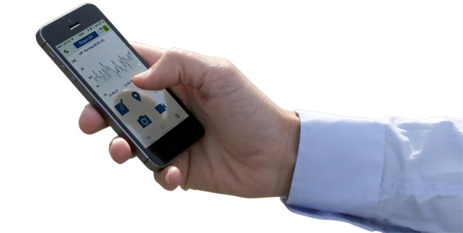
Control and annotate your measurement with the Field App
The Field App is an advanced companion app to Type 2250 offering remote instrument control, display, annotation of measurement data and cloud support. It supports all annotation types such as note, voice commentary, image, video and GPS. All annotations are uploaded to Measurement Partner Cloud for merging with the analyzer project in Measurement Partner Suite, transforming the way you work with your Type 2250 analyzer in the field.

Slide 53
Personal Noise Dose Meter
Uses
Assessment of noise exposure at work
Occupational noise evaluation
Selection of hearing protection

Slide 54
Measuring Sound-Pressure Level:
A sound-level meter (SLM) is designed to give readings of sound-pressure level.
Sound pressure in decibels is referenced to the standard reference level, 20 μPa.
The human hearing response is not flat across the audio band.

Slide 55
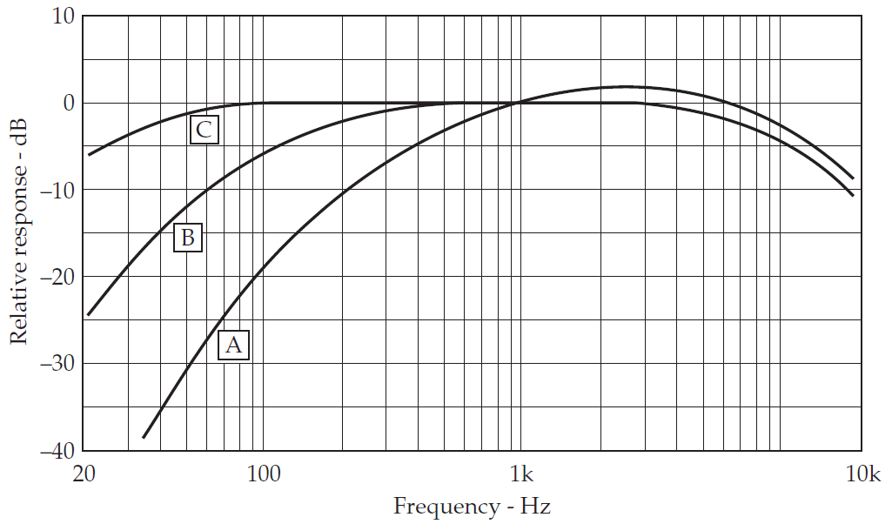
The A, B, and C weighting response characteristics for sound-level meters.

Slide 56
Network selection is based on the general level of sounds to be measured (background noise, jet engines, and so on).
For example:
For sound-pressure levels of 20 to 55 dB, use network A.
For sound-pressure levels of 55 to 85 dB, use network B.
For sound-pressure levels of 85 to 140 dB, use network C.

Slide 57
These network response shapes were designed to bring the sound-level meter readings into closer conformance to the relative loudness of sounds.
However, the B and C weightings often do not correspond to human perception.
The A weighting is more commonly used.
When a measurement is made with the A weighting, the value is designated as dBA.

Slide 58
Measurement strategy:
Three procedures are available for the use of measuring devices, the characteristics of which are outlined in Figure:
a) Continuous measurements
b) Sampling measurements, directed by an operator.
c) Random sampling

Slide 59
a) Continuous measurements
Every exposure interval is continuously measured using a dosimeter worn by the subject.
b) Sampling measurements, directed by an operator.
The operator responsible for the measurements chooses when to begin sampling during the measurement process, and carries out the measurements using an integrated sound level meter Each measurement lasts at least a few minutes, but a sufficiently large number of measurements is taken.

Slide 60
…
c) Random sampling
The random selection of measurement times during the observation intervals is one of the recommended methods of obtaining representative samples.
A sufficiently large number of data points is taken (at least 10), and it must be verified that there are no systematic, non-random variations among the measured noise levels.

Slide 61
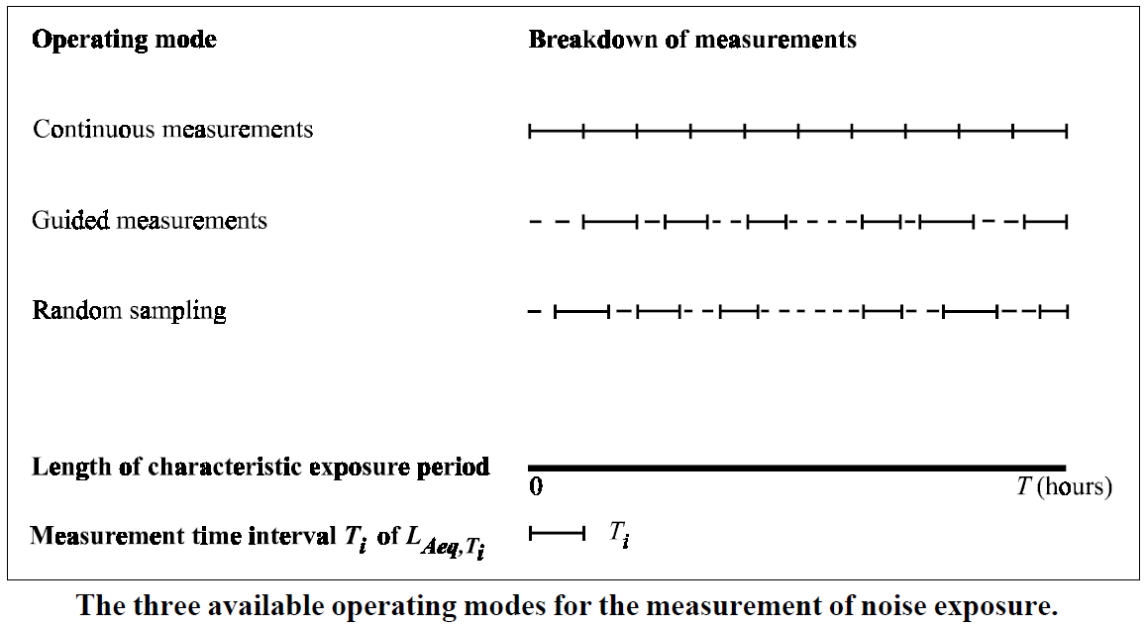

Slide 62
How does one choose the method that is best adapted to the exposure situation at hand?
Continuous measurements using a personal dosimeter can always be used. It is also the only method adapted to situations where the workers are highly mobile, or when they operate in confined spaces.

Slide 63
Guided sampling techniques can be used in situations where the noise exposure has been previously evaluated and where there are some data available that can be used to avoid any bias in the sampling introduced by the operator's selection of measurement times.
Random sampling methods can be used for a wide range of applications, but are the most difficult to implement.
Noise measurements/surveys are carried out to establish/identify on a workplace basis the type, the nature and the extent of the noise problem.

Slide 64
بخش سوم:
راهکارهای کنترل صدا در محیط کار

Slide 65
To adequately define the noise problem and set a good basis for the control strategy, the following factors should be considered:
type of noise
noise levels and temporal pattern
frequency distribution
noise sources (location, power, directivity)
noise propagation pathways, through air or through structure
room acoustics (reverberation).

Slide 66
GENERAL SOURCE NOISE CONTROL CAN INVOLVE:
Maintenance
Substitution of materials
Substitution of equipment
Specification of quiet equipment
Substitution of parts of equipment
Change of work methods
Substitution of processes
substitution of mechanical power generation and transmission equipment
replacement of worn moving parts
minimizing the number of noisy machines running at any one time

Slide 67
1. Maintenance:
replacement or adjustment of worn or loose parts;
balancing of unbalanced equipment;
lubrication of moving parts;
use of properly shaped and sharpened cutting tools.

Slide 68
2. Substitution of materials:
(e.g., plastic for metal)
a good example being the replacement of steel sprockets in chain drives with sprockets made from flexible polyamide plastics.

Slide 69
3. Substitution of equipment:
electric for pneumatic (e.g. hand tools);
stepped dies rather than single-operation dies;
rotating shears rather than square shears;
hydraulic rather than mechanical presses;
presses rather than hammers;
belt conveyors rather than roller conveyors.

Slide 70
4. Specification of quiet equipment
5. Substitution of parts of equipment:
modification of gear teeth
replace straight edged cutters with spiral cutters
replace gear drives with belt drives;
replace metal gears with plastic gears;
replace steel or solid wheels with pneumatic tires.

Slide 71
6. Change of work methods:
replace pneumatic tools by changing manufacturing methods;
use remote control of noisy equipment such as pneumatic tools;
separate noisy workers in time, but keep noisy operations in the same area, separated from non-noisy processes;
select slowest machine speed appropriate for a job;
minimize width of tools in contact with work piece;

Slide 72
7. Substitution of processes:
mechanical ejectors for pneumatic ejectors;
hot for cold working;
pressing for rolling or forging;
welding for riveting;
use cutting fluid in machining processes;
replace mechanical limit stops with micro-switches.

Slide 73
…
change from impact action to progressive pressure action;
replace circular saw blades with damped blades.

Slide 74
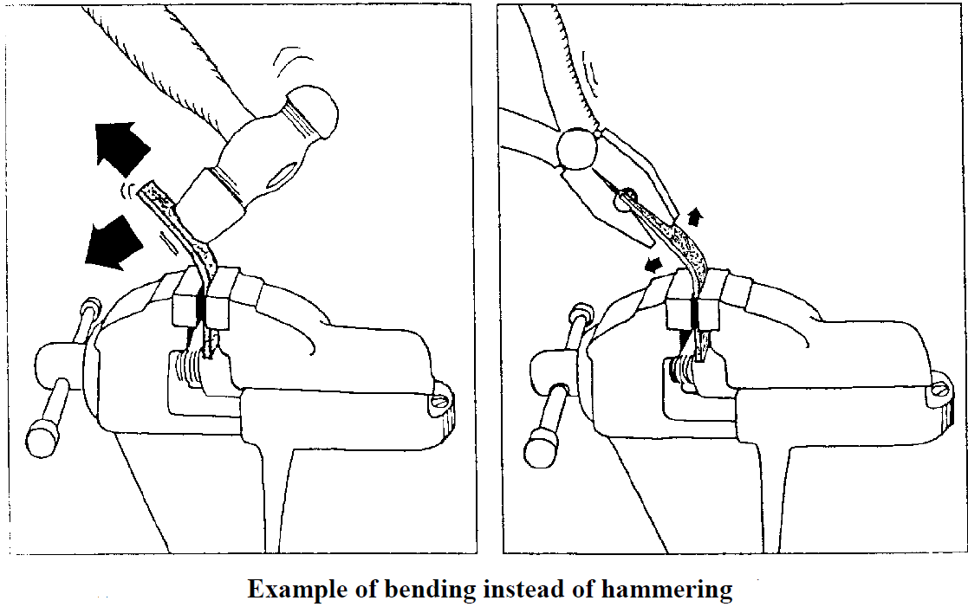

Slide 75
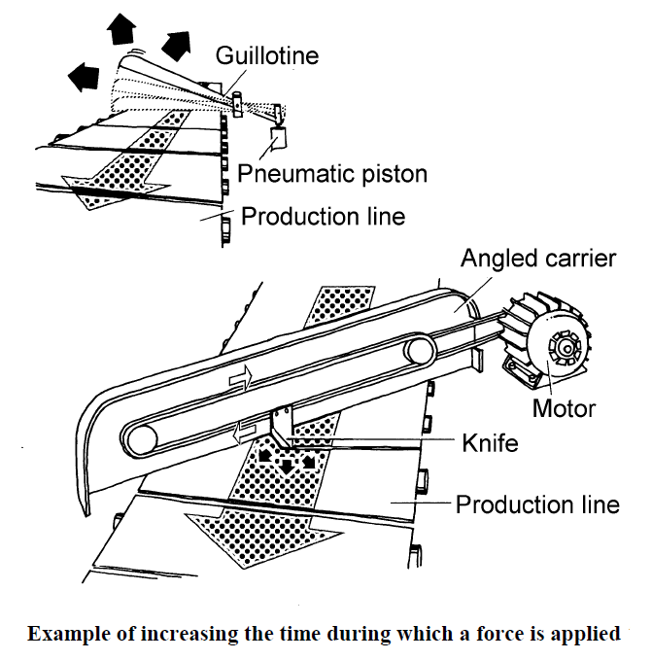

Slide 76
8. substitution of mechanical power generation and transmission equipment:
electric motors for internal combustion engines or gas turbines;
belts or hydraulic power transmissions for gear boxes.

Slide 77
9. replacement of worn moving parts:
10. minimizing the number of noisy machines running at any one time

Slide 78
SOURCE CONTROL BY DESIGN INVOLVES:
Reduction of mechanical shock between parts
Reduction of noise resulting from out-of-balance
Reduction of noise resulting from friction between metal parts
Reduction of noise resulting from the vibration of large structures
Reduction of noise resulting from fluid flow

Slide 79
1. Reduction of mechanical shock between parts:
modifying parts to prevent rattle and ringing;
using an adjustable height collector for parts falling into a bin, so that impact speed and thus radiated noise is reduced;
using an adjustable height conveyor and rubber flaps to minimize the fall height of the parts;
lining of tumbling barrels, parts collecting bins, metal chutes, hoppers, etc.
covering metal tables, metal wheels, etc. with a material, such as rubber;
using conveyor belts instead of chutes to avoid noisy falls.

Slide 80
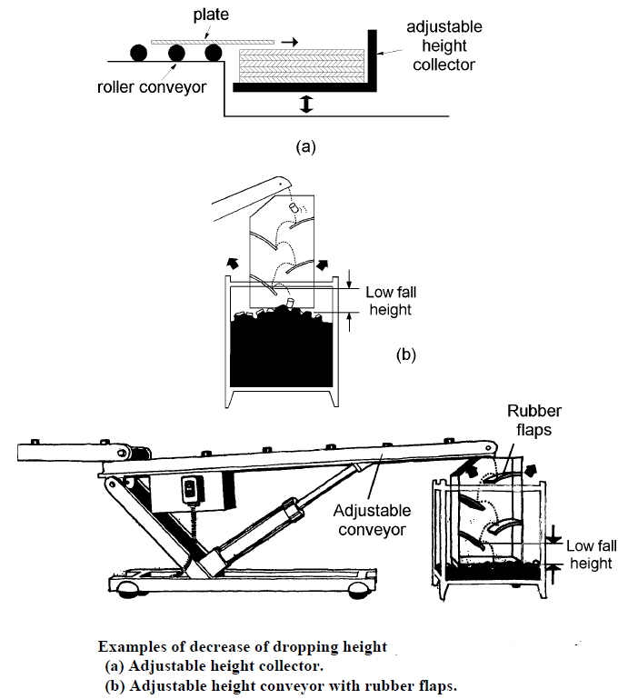

Slide 81
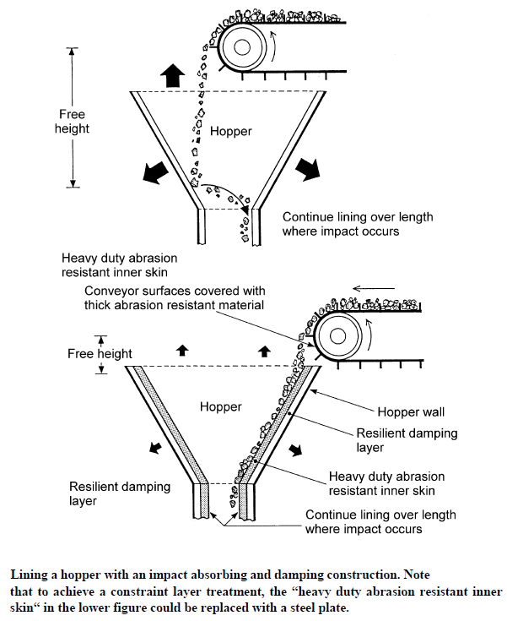

Slide 82
2. Reduction of noise resulting from out-of-balance:
balancing moving parts;
use of vibration absorbers and dampers tuned to equipment resonances.

Slide 83
3. Reduction of noise resulting from friction between metal parts:
lubrication or use of soft elastic interspacing

Slide 84
4. Reduction of noise resulting from the vibration of large structures:
ensuring that machine rotational speeds do not coincide with resonance frequencies of the supporting structure
reducing the acoustic radiation efficiency of the vibrating surface
damping a panel if it is excited mechanically
reducing area of radiating surfaces

Slide 85
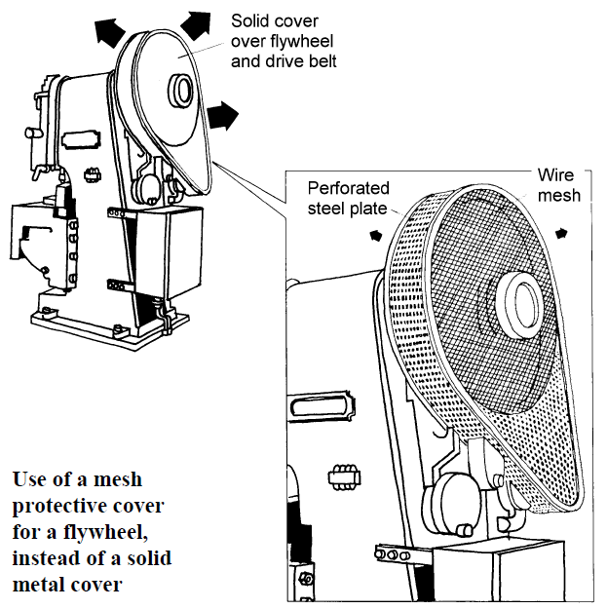

Slide 86
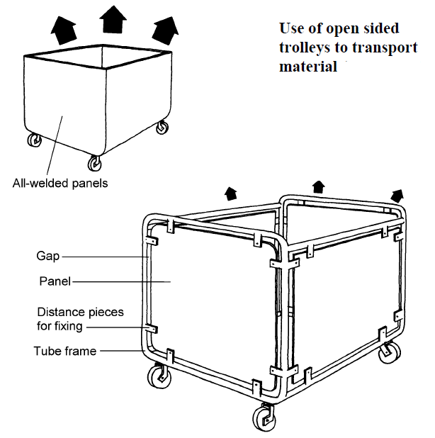

Slide 87
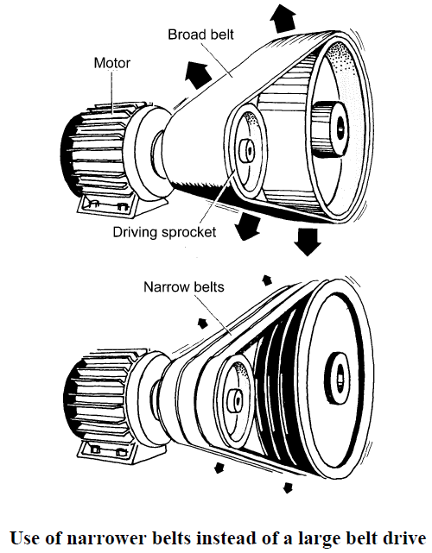

Slide 88
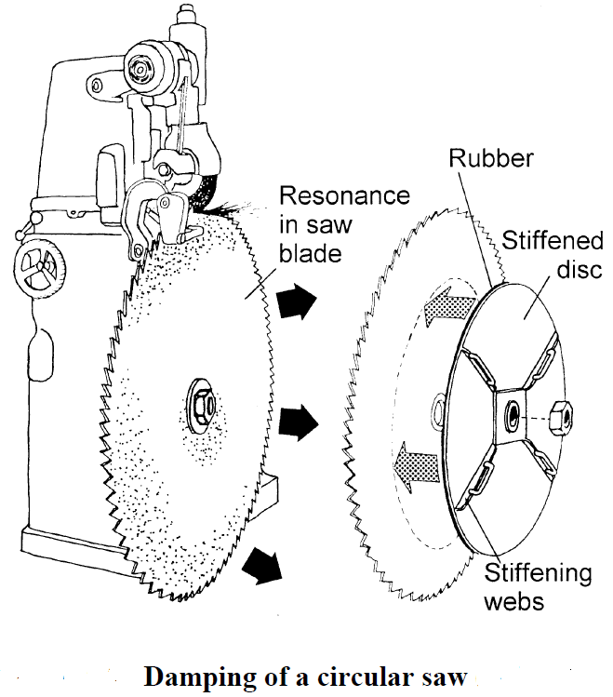

Slide 89
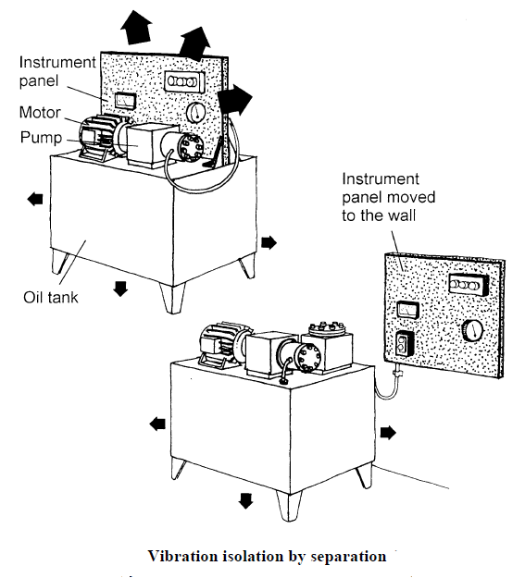

Slide 90
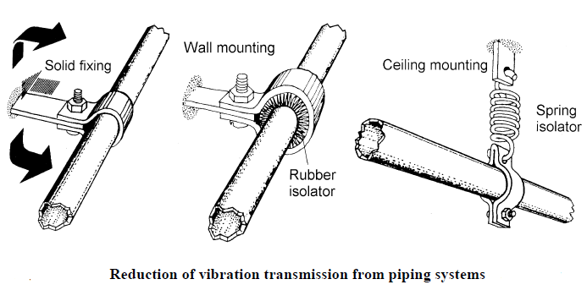

Slide 91
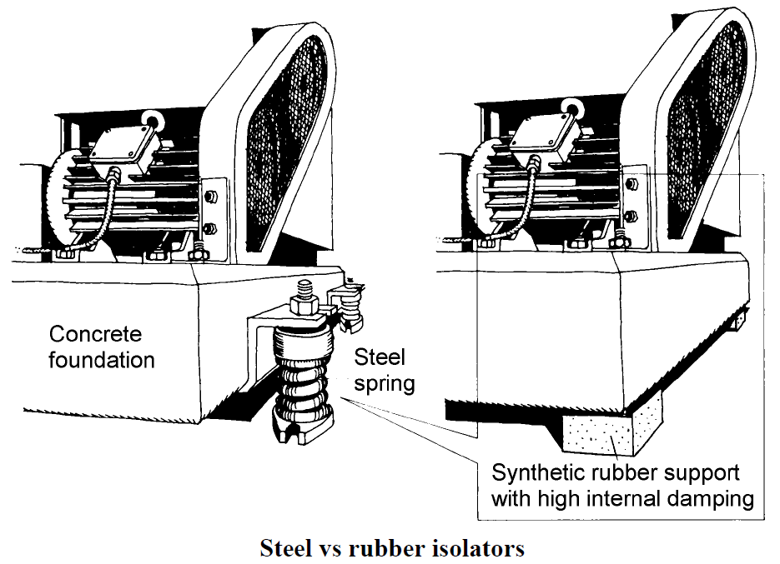

Slide 92
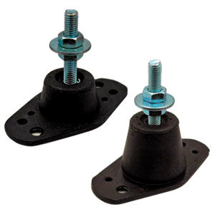
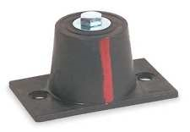
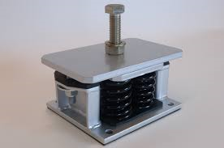
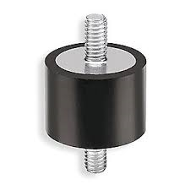

Slide 93
5. Reduction of noise resulting from fluid flow:
providing machines with adequate cooling fins so that noisy fans are no longer needed;
using centrifugal rather than propeller fans when fan use is unavoidable;
locating fans in smooth, undisturbed air flow;
using curved fan blades designed to minimize turbulence or use irregular spacing in fans with straight blades as in traction motors;
using of large, low speed fans rather than smaller, faster ones;
minimizing velocity of fluid flow and increase cross-section of fluid streams;

Slide 94
…
reducing the pressure drop across any one component in a fluid flow system;
minimizing fluid turbulence where possible;
choosing quiet pumps in hydraulic systems;
choosing quiet nozzles for compressed air systems;
isolating pipes carrying the fluid from support structures;
using flexible connectors in pipe systems to control energy travelling in the fluid as well as the pipe wall;
using flexible fabric sections in low pressure air ducts (near the noise source such as a fan).

Slide 95
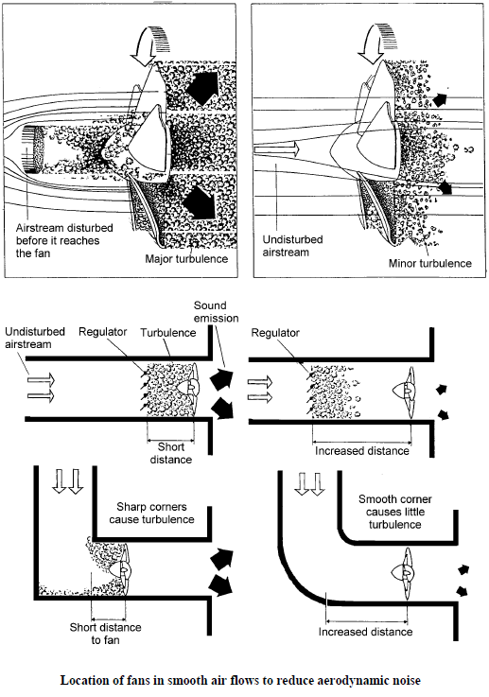

Slide 96
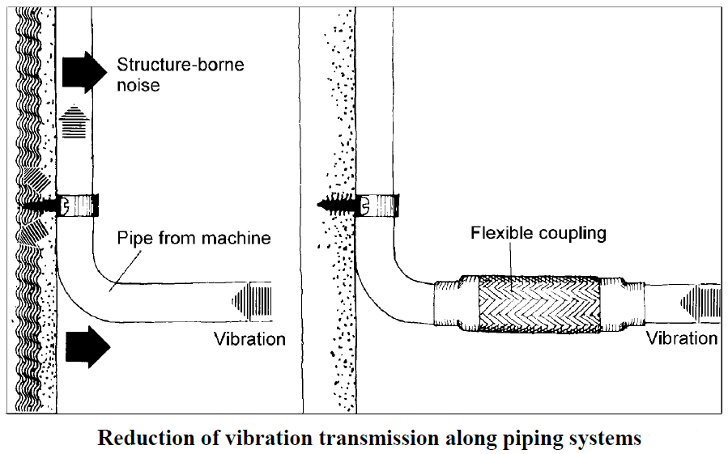

Slide 97
CONTROL OF NOISE PROPAGATION:
Use of barriers (single walls), partial enclosures or full enclosure of the entire item of equipment.
Use of local enclosures for noisy components on a machine.
Use of reactive or dissipative mufflers; the former for low frequency noise or small exhausts, the latter for high frequencies or large diameter exhaust outlets.
Use of lined ducts or lined plenum chambers for air handling systems
Reverberation control - the addition of sound absorbing material to reverberant spaces to reduce reflected noise fields.
Active noise control, which involves suppression, reflection or absorption of the noise radiated by an existing sound source by use of one or more secondary or control sources.

Slide 98
Isolation of noise and transmission loss:
The noise generated by a source can be prevented from reaching a worker by means of an obstacle to its propagation, conveniently located between the source and worker. This is the concept of sound isolation. Although one would ideally like the obstacle to isolate the noise completely, in practice, some of the noise always passes through it and the amount by which the noise is reduced by the obstacle, in dB, is dependent on the noise reducing properties of the material (its "transmission loss") and the acoustic properties of the room into which the noise is being transmitted.

Slide 99
Enclosures:
The first task to consider in the design of an acoustic enclosure of a noise source is to determine the transmission paths from the source to the receiver and order them in relative importance. For example, on close inspection it may transpire that, although the source of noise is readily identified, the important acoustic radiation originates elsewhere, from structures mechanically connected to the source. In this case structure-borne sound is more important than the airborne component. In considering enclosures for noise control one must always guard against such a possibility; if structure-borne sound is the problem, an enclosure to contain airborne sound can be completely useless.

Slide 100
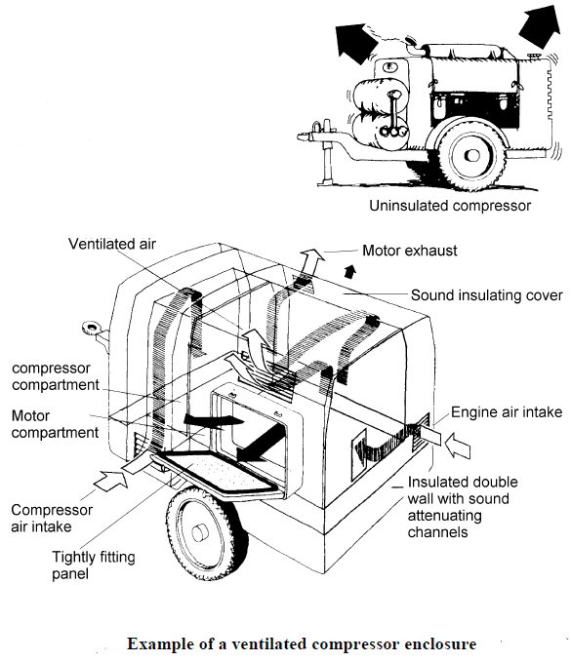

Slide 101
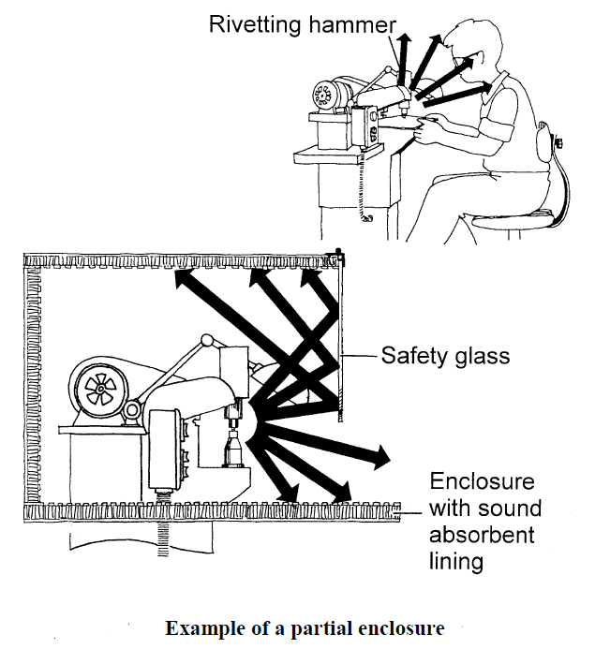

Slide 102
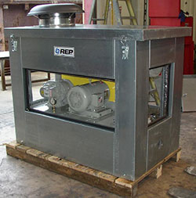
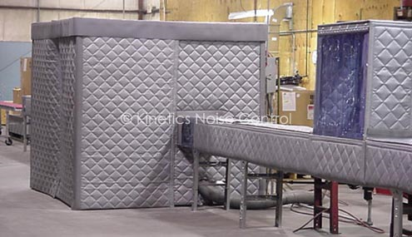

Slide 103
Acoustic barriers:
Barriers are placed between a noise source and a receiver as a means of reducing the direct sound observed by the receiver. In rooms, barriers suitably treated with sound-absorbing material may also slightly attenuate reverberant sound field levels by increasing the overall room absorption. Barriers are a form of partial enclosure usually intended to reduce the direct sound field radiated in one direction only. For non-porous barriers having sufficient surface density, the sound reaching the receiver will be entirely due to diffraction around the barrier boundaries.

Slide 104
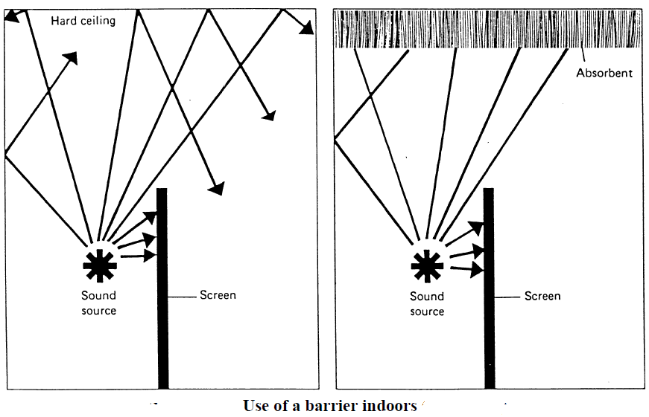

Slide 105
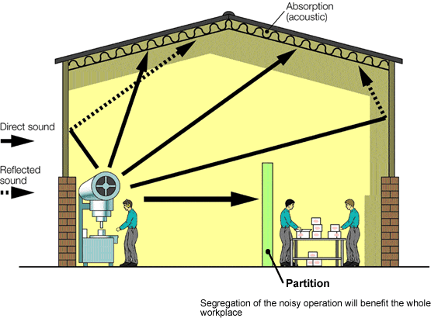

Slide 106
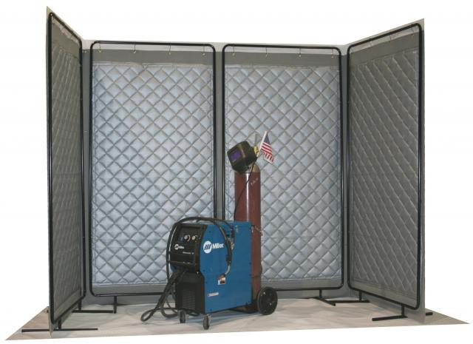

Slide 107
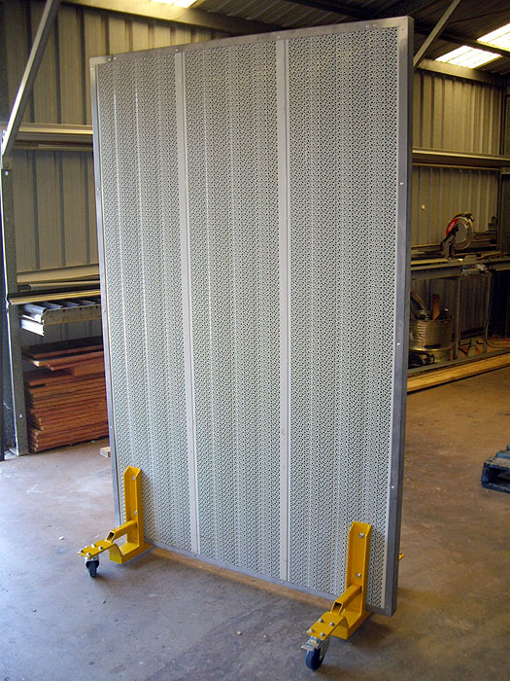

Slide 108
Mufflers and lined ducts:
Muffling devices are commonly used to reduce noise associated with internal combustion engine exhausts, high pressure gas or steam vents, compressors and fans. These examples lead to the conclusion that a muffling device allows the passage of fluid while at the same time restricting the free passage of sound. Muffling devices might also be used where direct access to the interior of a noise containing enclosure is required, but through which no steady flow of gas is necessarily to be maintained. For example, an acoustically treated entry way between a noisy and a quiet area in a building or factory might be considered as a muffling device.

Slide 109
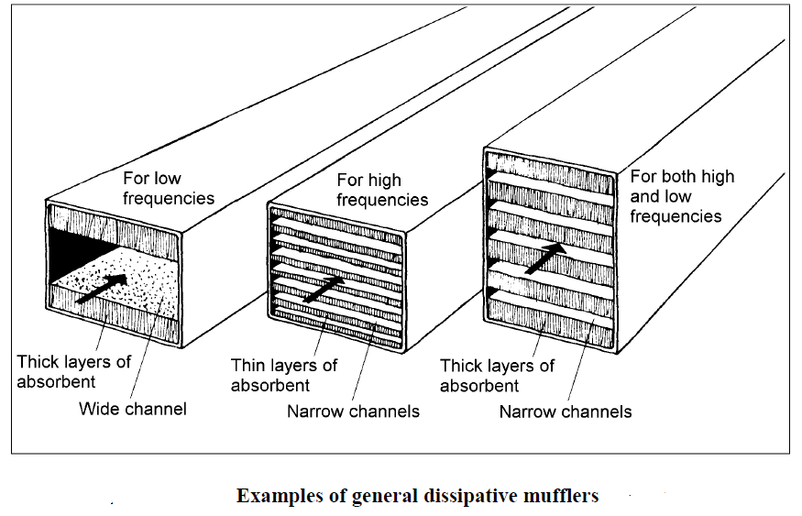

Slide 110
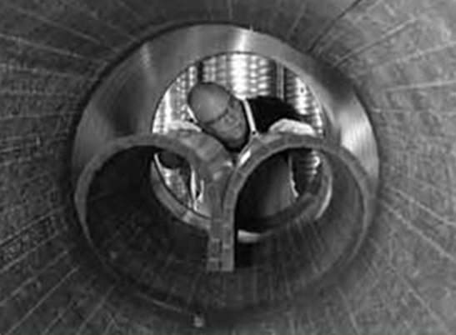

Slide 111
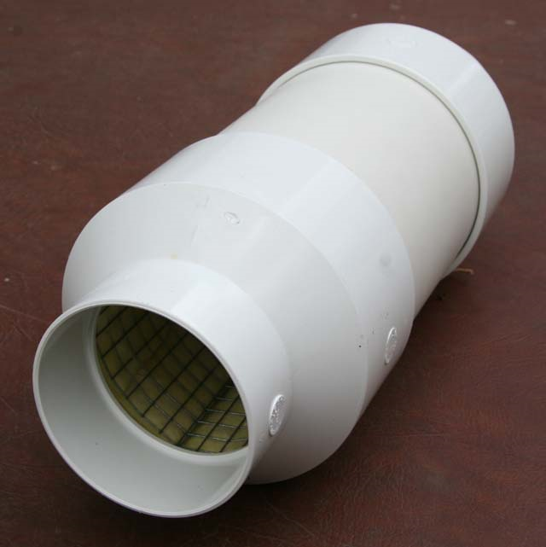
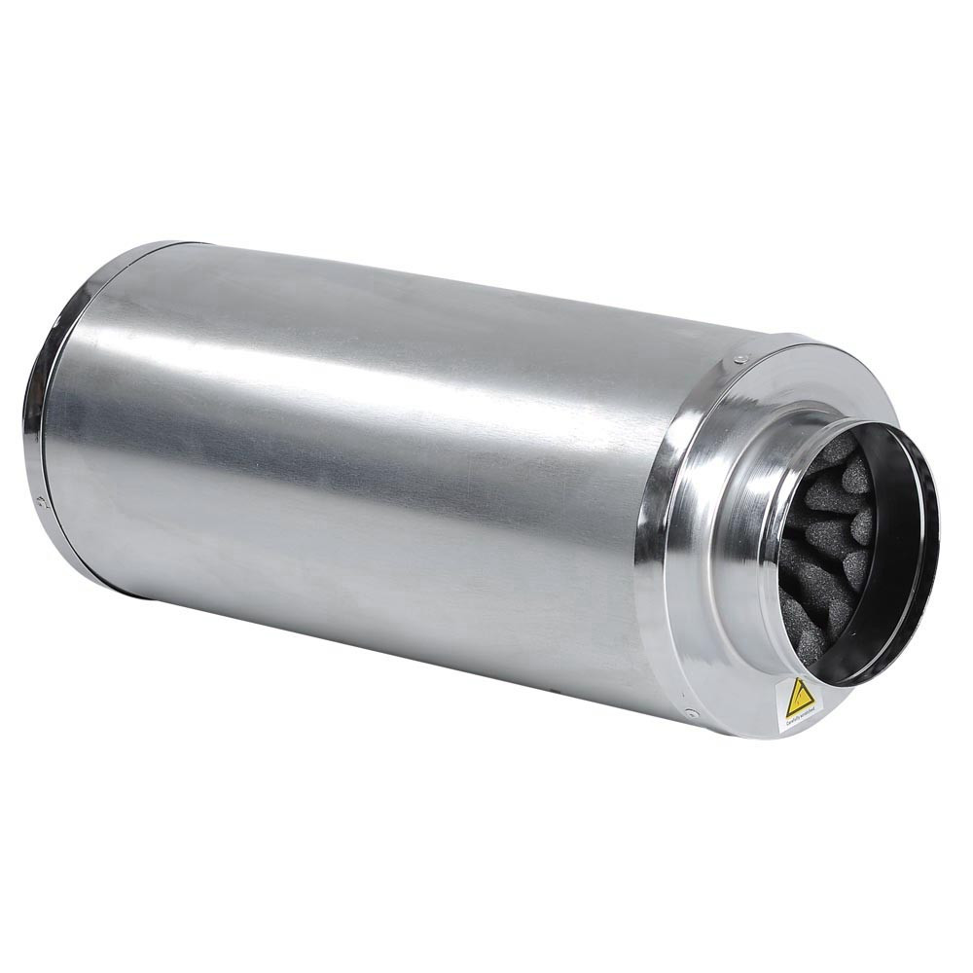

Slide 112
Reverberation:
When sound reflects within boundaries, it "accumulates" as a result of the addition of the reflected sound to the original sound. Sound may continue even after the original source stops - this is called "reverberation".
Thus a reverberant field is one which is characterized by sound which has been reflected from at least one surface in a particular room or enclosure. When the enclosure boundaries are hard and reflective, the reverberant field can easily dominate the sound arriving directly (without reflection) from a particular sound source and this will become increasingly likely as the distance from the sound source is increased.

Slide 113
Active Noise Control (ANC):
Active control of noise is the process of reducing existing noise by the introduction of additional noise by means of one or more secondary (or control) noise sources. The introduced noise may achieve the required noise reduction by way of any one or combination of three different physical mechanisms. One mechanism which is often used to describe the active control of noise in the popular press is that of sound field cancellation; that is, the introduced control sound is anti-phase to the original sound and cancellation results. This mechanism characterizes cases where noise reduction is achieved in small local areas surrounding a control source; however, local areas of cancellation are always balanced by other areas of reinforcement where the sound level is increased.

Slide 114
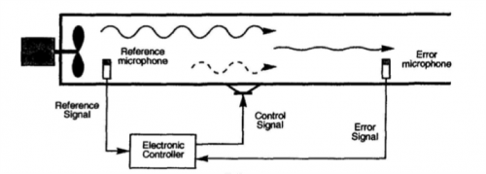

Slide 115
Separation of source and receiver:
Another type of noise propagation control is the separation, which can be by distance or in time. As the direct field radiated by a source generally decreases by 6 dB for each doubling of the distance from it (after the initial 1 meter), separating the source and receiver by distance is beneficial.
Noisy operations can also be separated in time; that is, they are performed out of the usual shift.

Slide 116
Guidelines which should be followed during design and construction are:
doors, windows and wall panels should be well sealed at edges;
interior surfaces of enclosure should be covered with sound absorptive material;
all ventilation openings should provided with acoustic attenuators.

Slide 117
RECEIVER CONTROL:
Receiver control in an industrial situation is generally restricted to providing headsets and/or ear plugs for the exposed workers. It must be emphasized that this is a last resort treatment and requires close supervision to ensure long term protection of workers' hearing. The main problems lie in ensuring that the devices fit adequately to provide the rated sound attenuation and that the devices are properly worn. Extensive education programs are needed in this regard.

Slide 118
…
Hearing protection is also uncomfortable for a large proportion of the workforce; it can lead to headaches, fungus infections in the ear canal, a higher rate of absenteeism and reduced work efficiency. It is worth remembering that the most protection that a properly fitted headset/earplug combination will provide is 30 dB, due to conduction through the bone structure of the head. In most cases, the noise reduction obtained is much less than this.

Slide 119
جمع بندی

Slide 120
References:
User Manual, Hand‐held Analyzer: Types 2250 and 2270 (B&K), February 2016.
Master Handbook of Acoustics. F.Alton Everest. 6th Edition. 2015.
Noise - Measurement of Workplace Noise. CCOHS. March 5, 2014
Occupational exposure to noise: evaluation, prevention and control, WHO, 2011.

Slide 121
باتشکر از حسن توجه شما

